Slide 1
Principles of Data Science
Li Niu

Slide 2
Data Preprocessing
Smooth data
Remove outliers
Fill in missing data
Quantize data

Slide 3
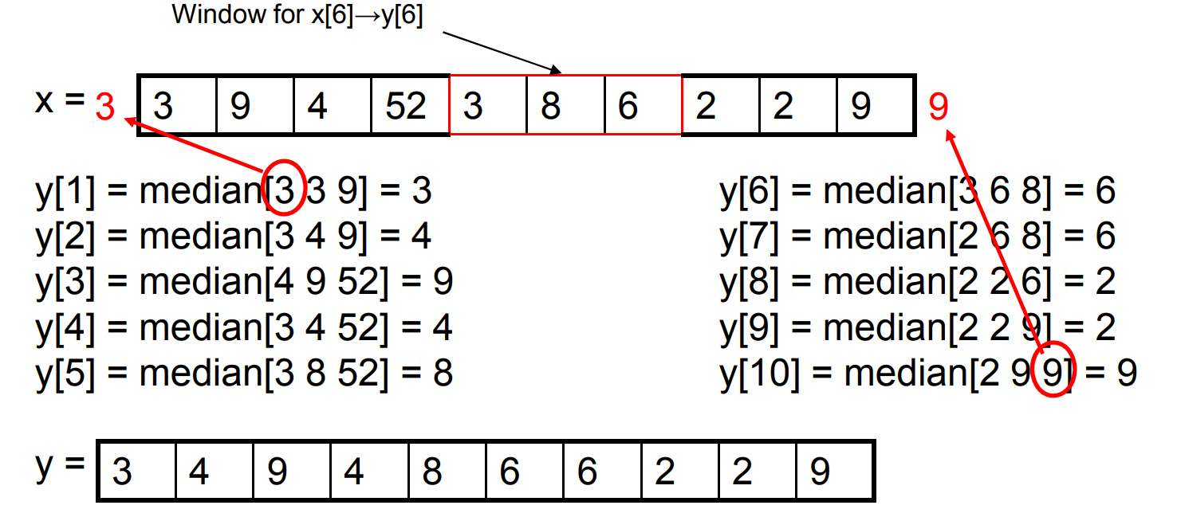
Median filter

Slide 4
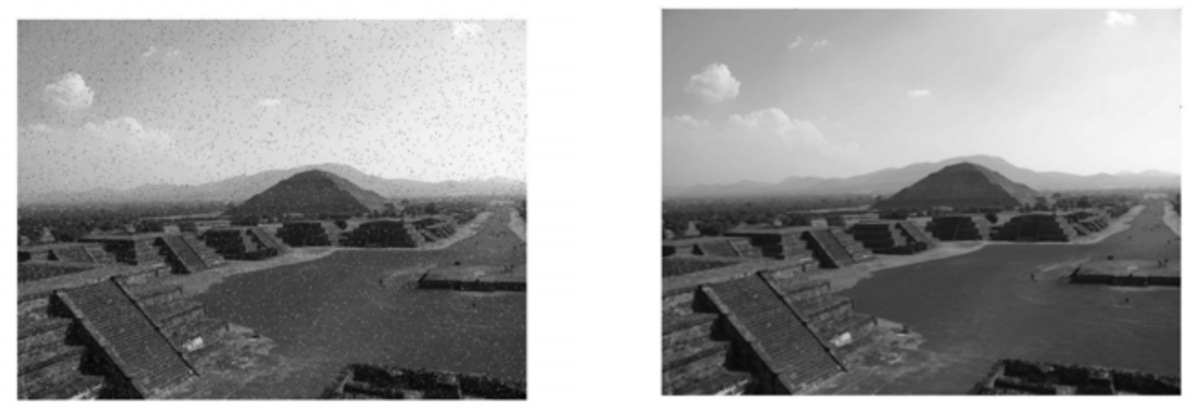
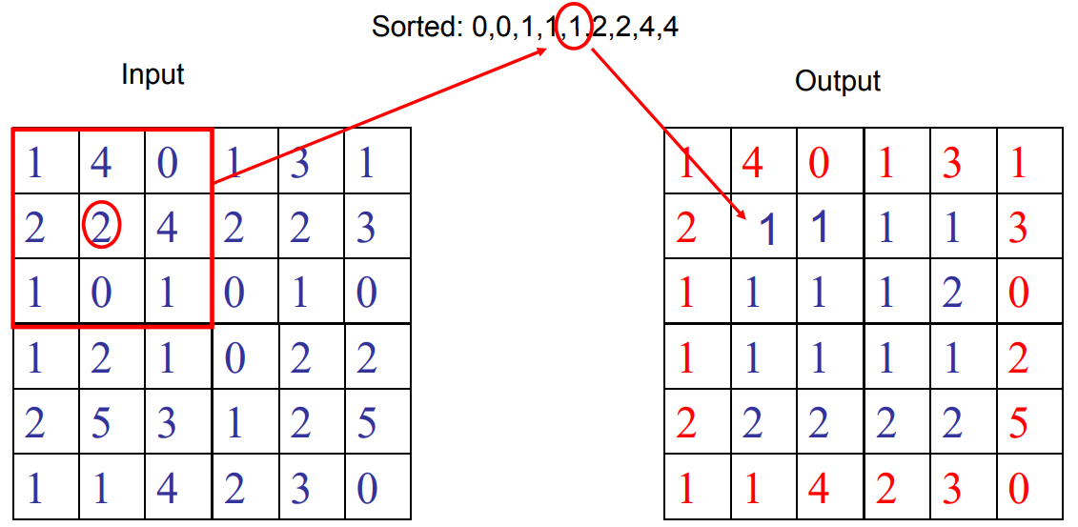
Median filter
image before median filtering
image after median filtering

Slide 5
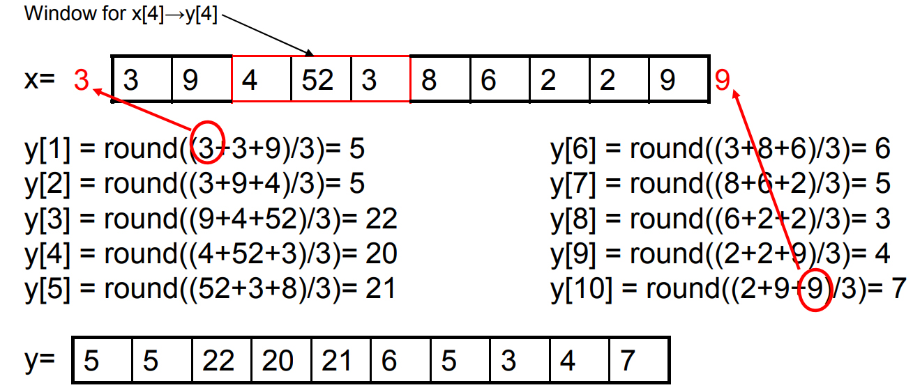
Mean filter

Slide 6
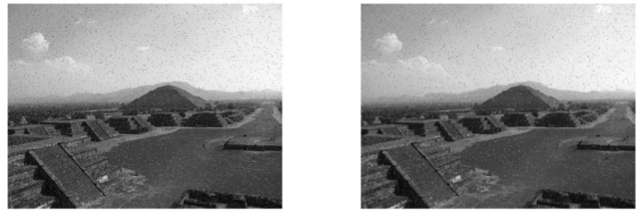
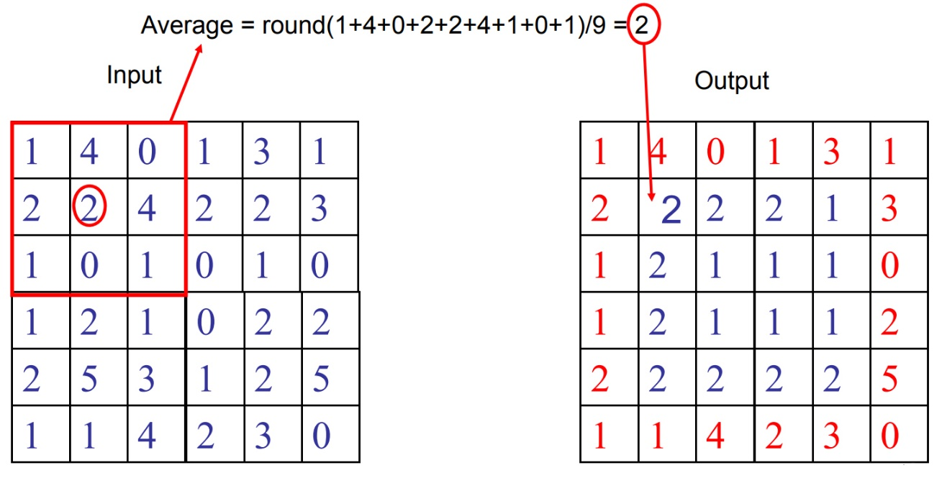
Mean filter

Slide 7
Pros and Cons
Median filter
Pros: preserve edges, insensitive to outlier
Cons: slow, unsmooth
Mean filter
Pros: fast, smooth
Cons: blur edges, sensitive to outlier

Slide 8
Data Preprocessing
Smooth data
Remove outliers
Fill in missing data
Quantize data

Slide 9
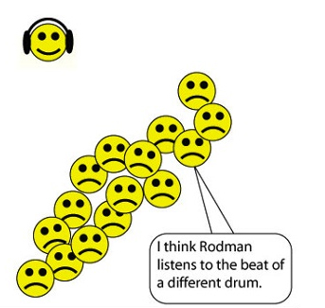
Remove outliers
: non-outliers
: outliers

Slide 10
Remove outliers
Statistical methods
use a model (e.g., Gaussian) to fit the distribution of all data
use two models to fit the distributions of non-outliers and outliers separately
Distance based methods
the density within a neighborhood
the distance from a nearest neighbor
Learning based method
clustering, the smallest cluster is likely to contain outliers
one-class classifier (e.g., one-class SVM)
binary classifier (e.g., naive Bayes for spam filtering, weighted binary SVM)

Slide 11
Data Preprocessing
Smooth data
Remove outliers
Fill in missing data
Quantize data

Slide 12
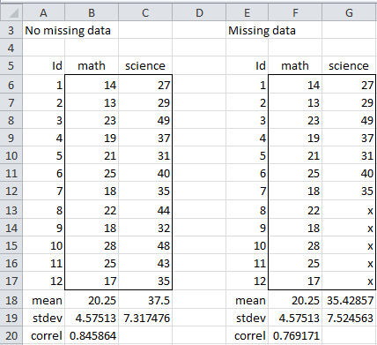
Fill in missing data
missing data

Slide 13
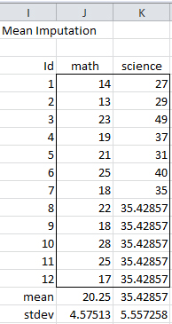
Fill in missing data
Fill in a constant (e.g., mean value)

Slide 14
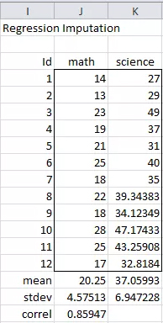
Fill in missing data
Fill in estimated values (e.g., regression)

Slide 15
Data Preprocessing
Smooth data
Remove outliers
Fill in missing data
Quantize data

Slide 16
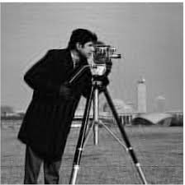

Binarization
Map continuous values to binary values (2 bins)
original image
binarized image

Slide 17
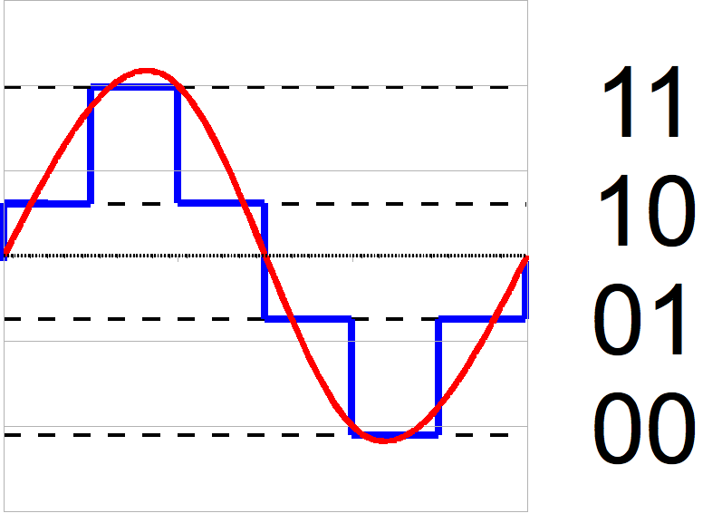
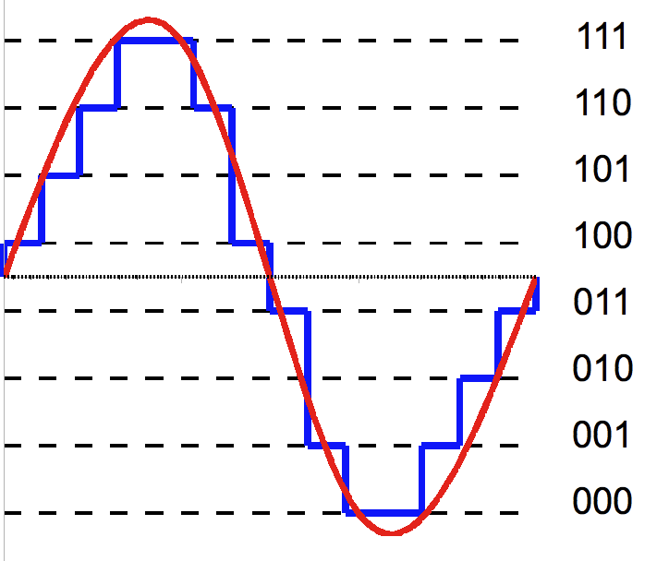
Quantization
Map continuous values to discrete values (more than 2 bins)
4 bins
8 bins

Slide 18
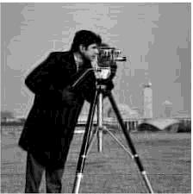

Quantization
original image
2 bins
16 bins
64 bins

Slide 19
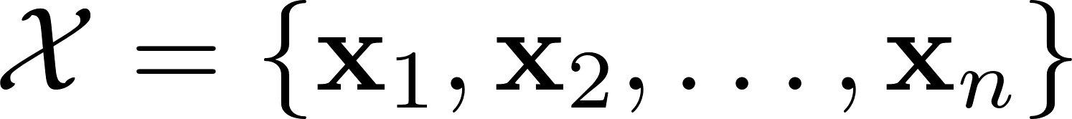
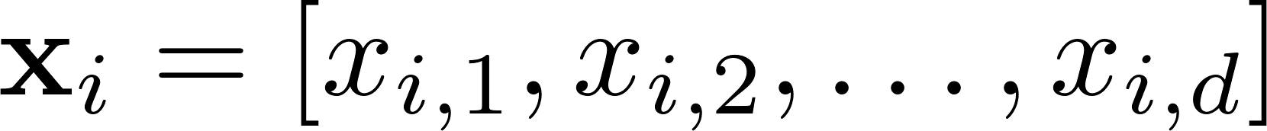
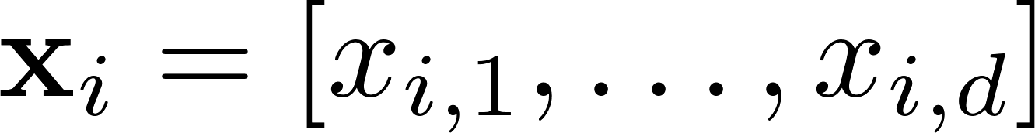
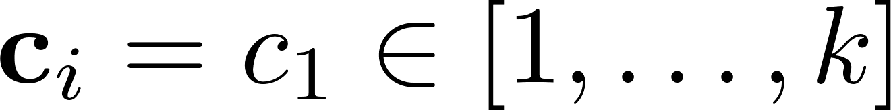
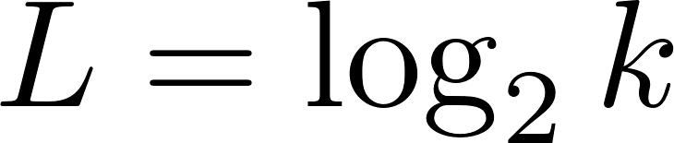
Quantization
with
learn a codebook of size k
codebook

Slide 20
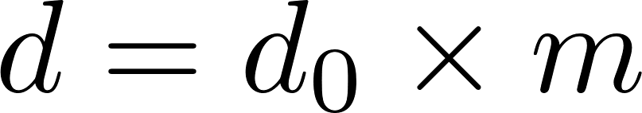
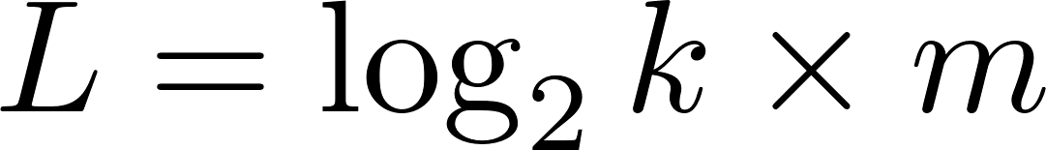
Product Quantization
with
learn a codebook of size k for each segment
codebook 1
codebook 2
codebook m

Slide 21
Thanks!

